Slide 1
Update from the COST Association to the Management Committee
Dr. Fatima Bouchama - Science Officer

Slide 2
CONTACT POINTS@ COST
Science Officer Dr Fatima Bouchama fatima.bouchama@cost.eu
Tel: +32 (0)2 533 38 32
Administrative Officer Ms Andrea Tortajada andrea.tortajada@cost.eu
Tel: +32 (0)2 533 38 90
Communications Officer Ms Silvia Alexe silvia.alexe@cost.eu Tel: +32 (0)2 533 3854

Slide 3
Science Communication Manager
Guidelines for Dissemination of COST Action Results and Outcomes
http://www.cost.eu/download/guidelines_action_dissemination_results_outcomes
The Action has elected one of its members as science communication manager :
Dr. Carlos Herdeiro
- Stays in contact with Comms Officer (Ms. Silvia Alexe ) who can disseminate through COST website important results/news of the Action and can help with drafting content (press releases, videos, etc.) with branding requirements & acknowledging COST.
- Can participate to science communication trainings organized by COST

Slide 4
Acknowledging COST Funds
It’s vital that you mention COST funding whenever you communicate your network’s achievements
It helps boost the programme’s visibility and impact (budget issues)
See our brand book for details on how to use our visual identity and acknowledge COST funding
http://www.cost.eu/media/dissemination-corporate-identity
Notes:
Insist again that when any type of activity is organised or co-organised by the Action it is mandatory to acknowledge COST and mention de Action name.

Slide 5
MANAGEMENT COMMITTEE
DECISION MAKING BODY
Coordination, Implementation, and Management of the Action:
→ Reporting, Membership approval, Dissemination and exploitation of results, Implementation of COST Policies
Supervising the appropriate allocation and use of funds
Achieving the Action’s MoU objectives

Slide 6
MANAGEMENT COMMITTEE/CORE GROUP
KEY ROLES IN ORDER TO ORGANIZE THE WORK
CORE GROUP:
Prepare MC decisions
Action Chair
Action Vice Chair
WG Leaders
GH Scientific Representative
STSM manager
Science Communication Manager
and other horizontal activities
CORE GROUP MEETINGS

Slide 7
MANAGEMENT COMMITTEE/CORE GROUP
TIPS
Deadline to e-cost invitations: (facilitate the organization of meetings)
The MC could decide to set a deadline to accept e-cost invitations on the platform (e.g. 2 or 3 weeks), after which the invitations will be automatically understood as declined and some other member can be invited.
Participants will always be informed about this deadline clearly
Mandate the Core Group for reallocation of funds up to a fixed amount (e.g. 5000 EUR)
The Core Group could then take fast decisions on behalf of MC but will report to the MC whenever such a decision is taken
Note: Mandates from the MC to the CG need to be related to specific decisions and within a well-defined framework.

Slide 8
SCIENTIFIC REPORTING
Monitor running Actions and assess ended Actions with regards to :
achievement of MoU objectives
provision of MoU deliverables
contribution to the COST Mission
implementation of COST policies

Slide 9
Monitoring and Final Assessment of Actions
Type | Time (months) | Content | Assessment/ Evaluation by
Progress Review 1 | 12 | Implementation of SC Recommendations & COST Policy on Excellence and Inclusiveness | Scientific Committee
Progress Review 2 | 24 | Progress Impacts and successes Dissemination & Exploitation Urgent needs for improvement | Independent External Expert
Final Assessment | 48 | MoU Achievements Expected Impact & Successes Dissemination & Exploitation Added value of the networking Success stories Emerging themes/ potentially important future developments | Independent External Expert

Slide 10
Progress Report 1: Month 12
Time line: April 2018
e-COST based reporting by Action Chair on behalf of MC
SC recommendation & COST policy on Excellence and Inclusiveness implementation analysis by the SC
SC analysis and outcome of PR1

Slide 11
GRANT PERIODS
Following Grant Periods:
GP1: 01 / 05 / 2017 → 30 / 04 / 2018
GP2: 01 / 05 / 2018 → 30 / 04 / 2019
GP3: 01 / 05 / 2019 → 30 / 04 / 2020
GP4: 01 / 05 / 2020 → 06 / 04 / 2020 (end date)

Slide 12
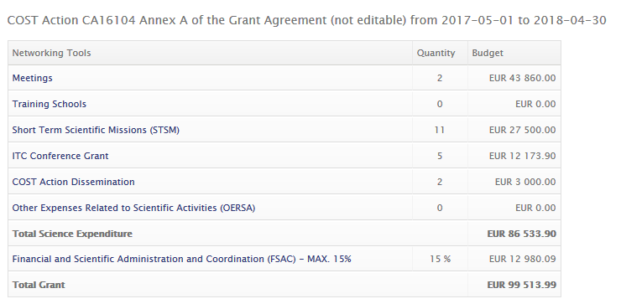
GP1: Amendment (top-up)
The COST Association has been granted extra budget (EUR 6.67 million) from the EC.
It has been decided to allocate this additional budget focussing on Networking Activities mainly by increasing the budget provided to all running COST Actions.
(new instrument ITC Conference Grants)

Slide 13
NEW : ITC Conference Grants
User Guide : http://www.cost.eu/ITC_conferencegrants_userguide
MC can nominate a ITC Conference Grants coordinator (by default it is MC Chair)
Aimed at supporting PhD students and ECI researchers from Participating ITCs
to attend international science and technology related conferences not specifically organised by the COST Action.
The applicant must:
make an oral/poster presentation at the conference in question on the topic of the Action and must acknowledge COST
be listed in the official event/conference programme.
Fill an application form in e-cost/ complete a scientific report

Slide 14
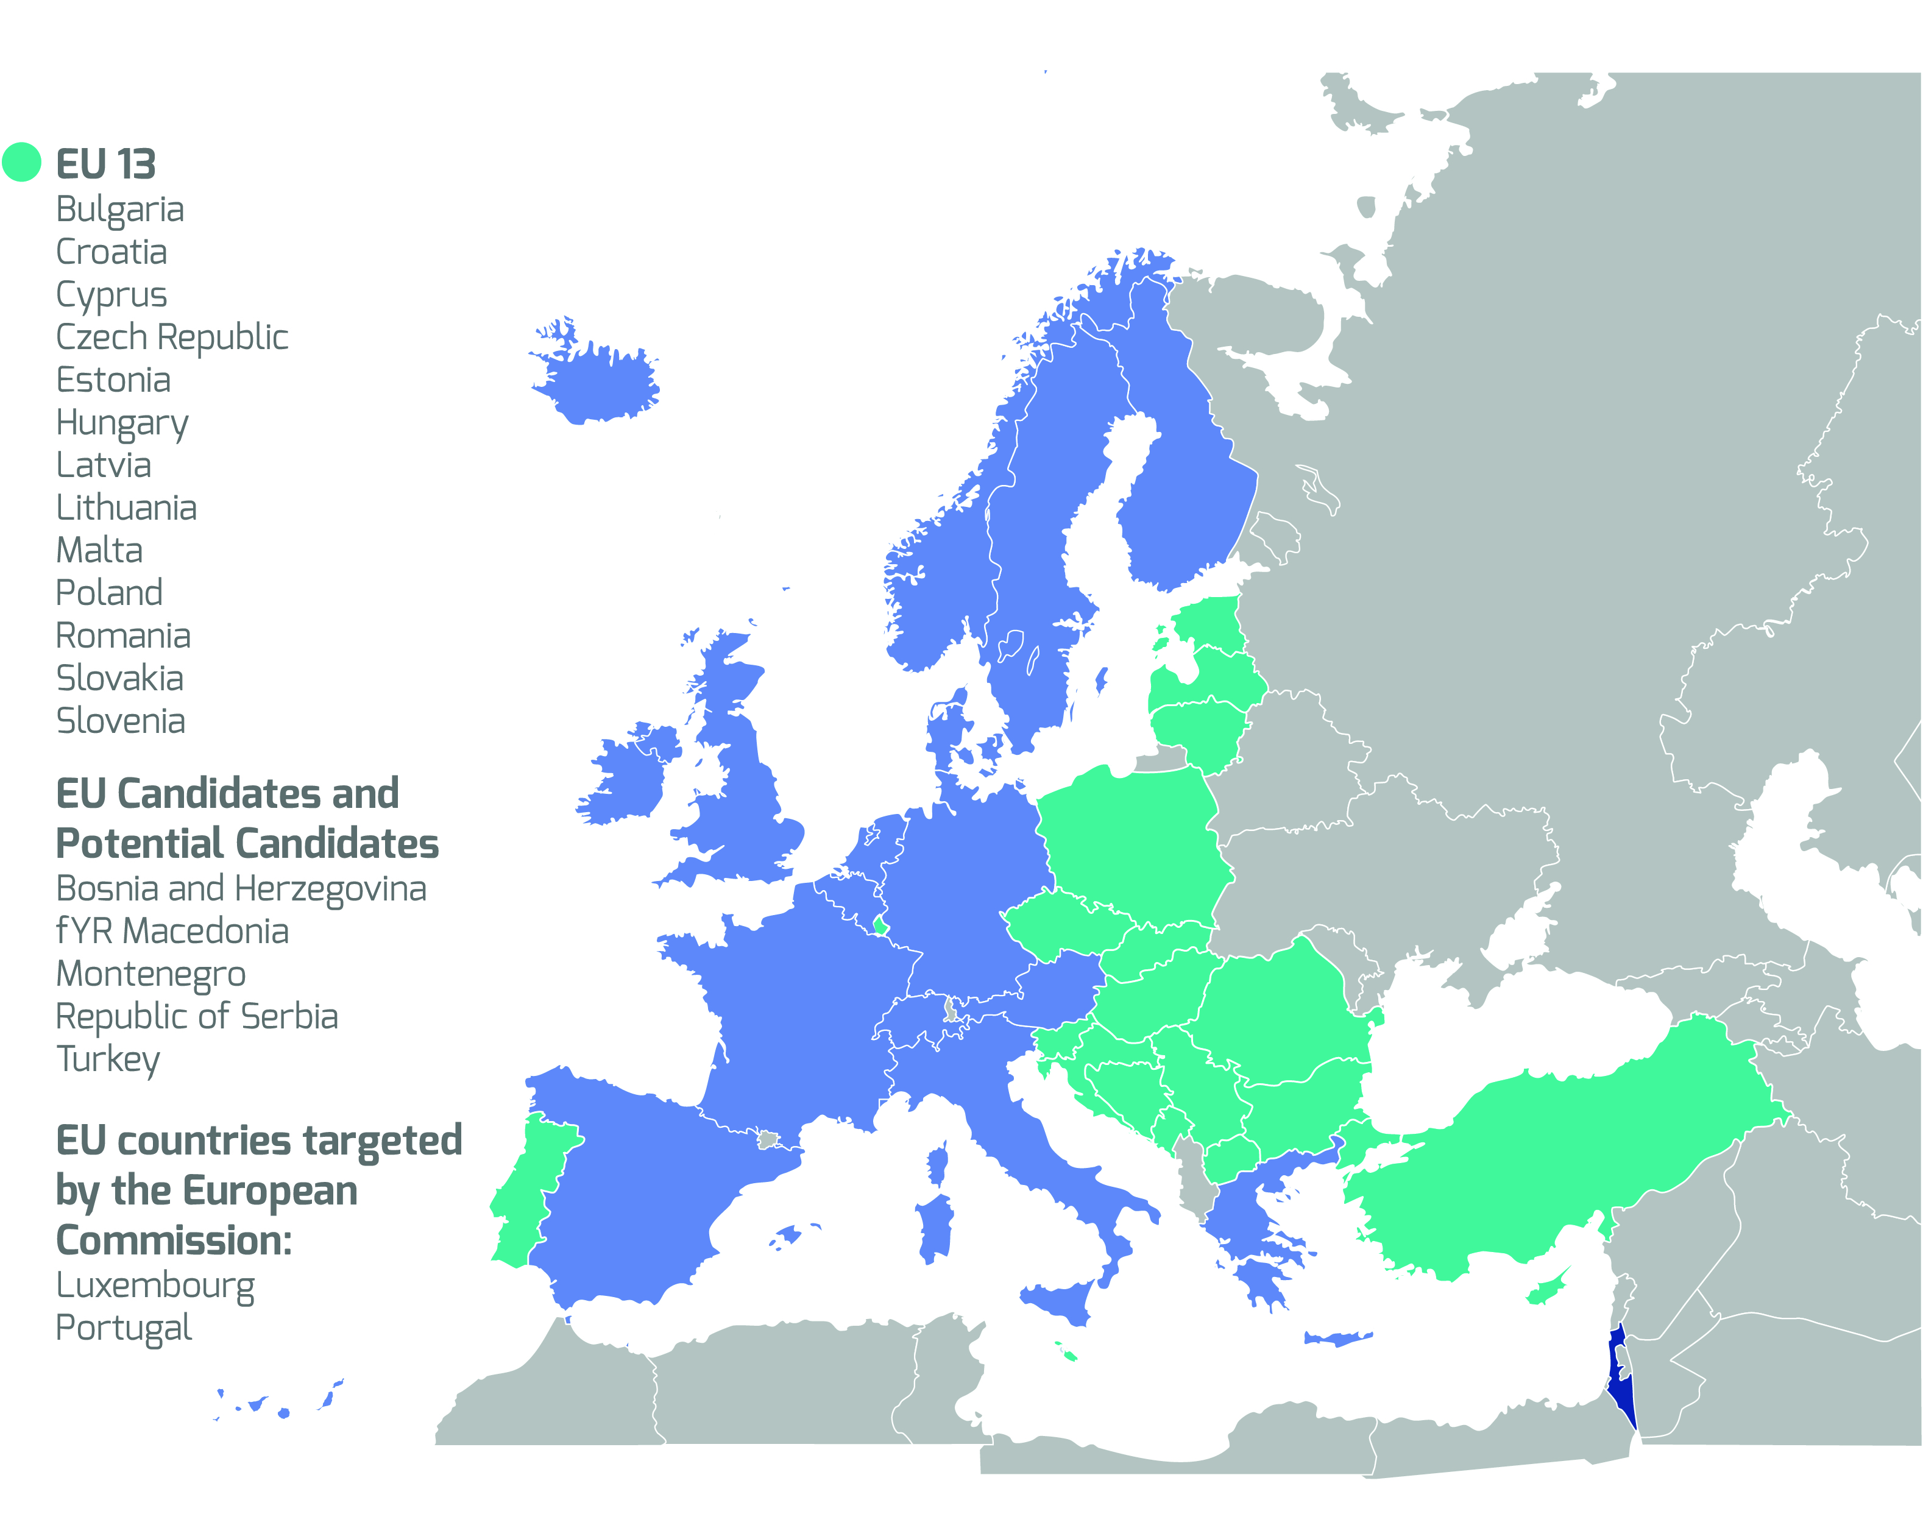
COST Inclusiveness Target Countries (ITC)
Notes:
Updated 19/07/2017 with newest map

Slide 15
GP2 : ALLOCATED BUDGET
2nd Grant period: 01/05/2018 – 30/04/2019
Allocated budget: 135.000 EUR (based on 25 COST Countries)
(Note: pending 2 parties: allocated budget can be higher if they join the Action before signature of the new AGA)
A. SUMMARY BUDGET
(1) MEETINGS
(2) TRAINING SCHOOLS
(3) SHORT-TERM SCIENTIFIC MISSIONS
(4) ITC CONFERENCES GRANTS
(5) COST ACTION DISSEMINATION
(6) OTHER EXPENSES RELATED TO SCIERNTIFIC ACTIVITIES (OERSA°
B. TOTAL SCIENCE EXPENDITURE (sum of (1) to (6))
C. Financial and Scientific Administration and Coordination (FSAC) (max. of 15% of B.)
D. TOTAL EXPENDITURE (B+C) = 135.000 EUR

Slide 16
UPDATES DOCUMENTS
See http://www.cost.eu/participate
Vademecum
http://www.cost.eu/download/COSTVademecum
Guidelines for Action Management, Monitoring and Assessment
http://www.cost.eu/download/Guidelines_Action_management_monitoring_assessment
Guidelines for Dissemination of COST Action Results and Outcomes
http://www.cost.eu/download/guidelines_action_dissemination_results_outcomes

Slide 17
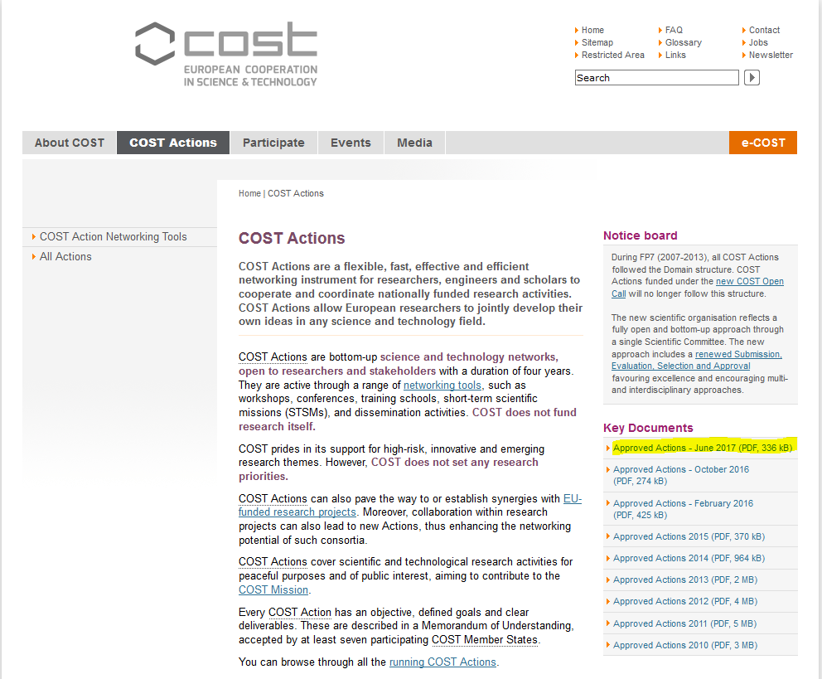
NEW ACTIONS: Full lists
http://www.cost.eu/COST_Actions

Slide 18
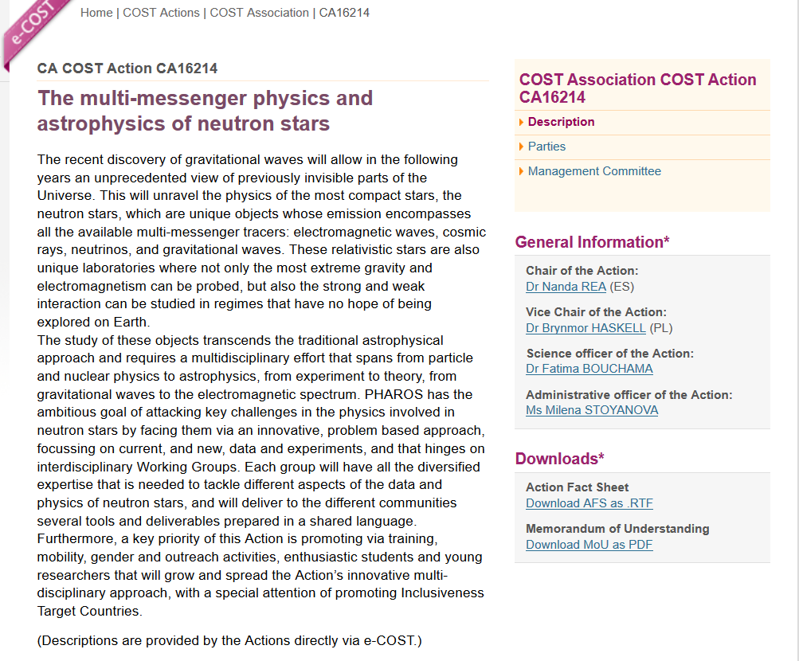
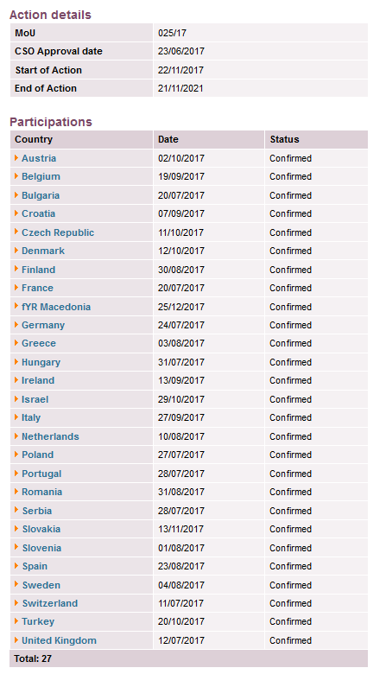
NEW ACTIONS: CA16214

Slide 19
Reminders
Any addition/revision of activities not in the approved WBP (Grant Agreement) needs MC and SO approval
Ensure total allocated budget is used
Always send to COST Association (SO and AO) the minutes of the MC meetings and upload them in e-COST
Notes:
Also cancellation of meetings is possible, if needed. Action Chairs should keep their SO informed about such cases.

Slide 20
Thank you!
COST Association
Avenue Louise 149
1050 Brussels, Belgium
T: +32 (0)2 533 3800
F: +32 (0)2 533 3890
www.cost.eu

Slide 21
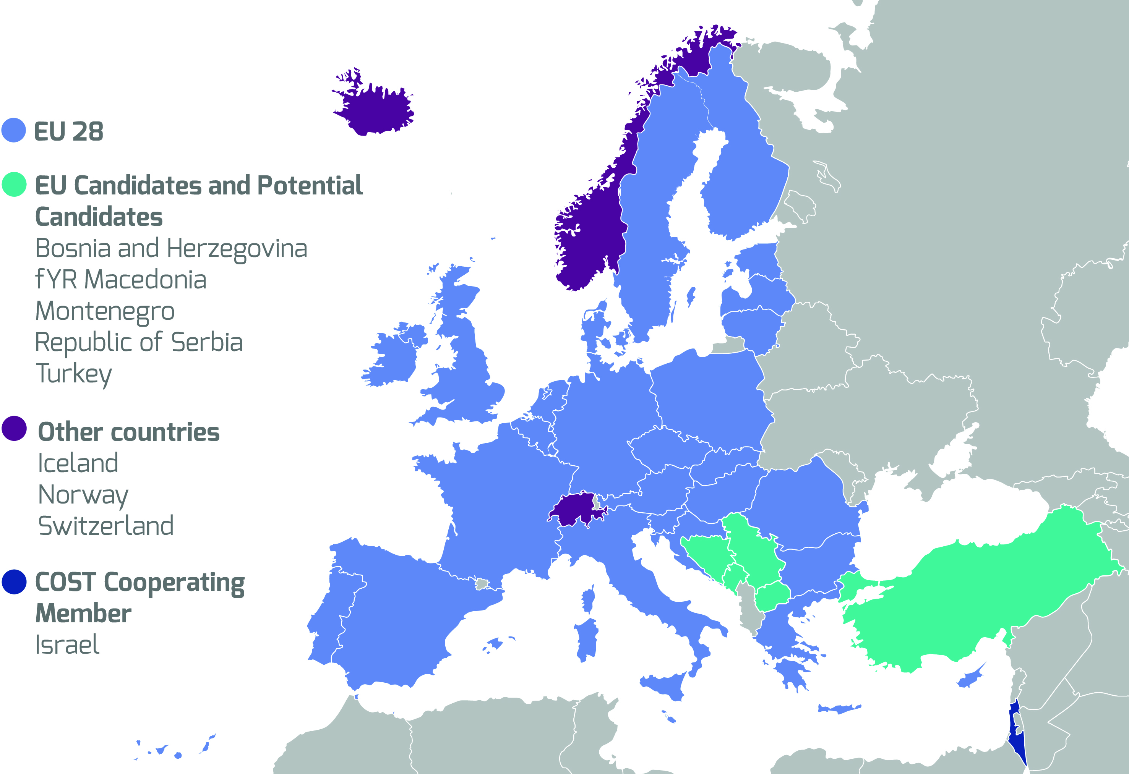
COST Member Countries

Slide 22
NNC and IPC
July 2017

