Slide 1
COST Action CA16104 Gravitational waves, black holes and fundamental physics
2nd MC meeting
Andrea Tortajada – 25th January – Malta

Slide 2
Content
1
News from COST
2
Status of the Action
3
Reimbursement Rules
4
Claims submission
5
Communication with COST Association

Slide 3
News from COST

Slide 4
Payment of the Grant
3rd payment
15%
2nd payment
35%
No carry over
of unspent funds
Sa1 1st payment
50%

Slide 5
STSM – Specific Provisions
Researchers from a Participating Inclusiveness Target Country (ITC)*:
50% of the grant upon completion of the 1st day
*Bosnia and Herzegovina, Bulgaria, Croatia, Cyprus, Czech Republic, Estonia, fYR Macedonia, Hungary, Latvia, Lithuania, Luxembourg, Malta, Montenegro, Poland, Portugal, Romania, Serbia, Slovakia, Slovenia, Turkey

Slide 6
ITC Conference Grants
PhD students and Early Career Investigators (ECI) with affiliation in a Participating Inclusiveness Target Country (ITC)
At least oral/poster presentation
Listed in the official programme
Pre-Approval by the MC

Slide 7
ITC Conference Grants – Financial Support
Maximum EUR 160 per day for accommodation and meals
Maximum EUR 2500 (including conference fees up to EUR 500)
Scientific report approved before payment

Slide 8
COST Branding for Dissemination
Reference: www.cost.eu/media/visualidentity
New COST Logo
EU Emblem
Accompanying text
To be used for:
Action website
Promotional materials
Publications
Final Action Dissemination

Slide 9
Status of the Action

Slide 10
Status of the Action
CSO Approval: 24/10/2016
Start date: 07/04/2017
End Date: 06/04/2021
Number of Parties: 25
New Parties: 2 intentions to participate (Austria and Norway)
Grant Holder: Instituto Superior Tecnico (PT)
Grant Holder Manager: Susana Oliveira

Slide 11
MC Decisions
MC MEETINGS
WRITTEN PROCEDURE / E-VOTE
2/3 of Participating COST Full Members/COST Cooperating Member
Majority vote with one vote per Participating COST Full Member/COST Cooperating Member
MC decision minuted and sent to COST Association
Initiated by MC Chair
All MC members
Vote open (7 days)
Majority vote with one vote per Participating COST Full Member/COST Cooperating Member
MC decision sent to COST Association and included in minutes of next MC Meeting

Slide 12
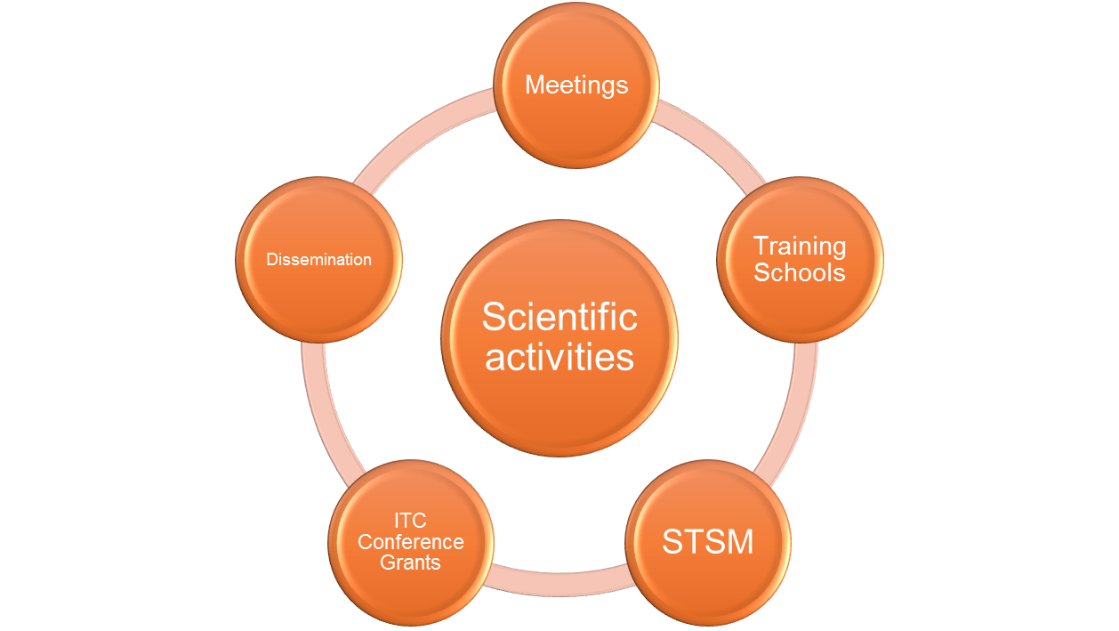
COST Networking Tools

Slide 13
Reimbursement Rules

Slide 14
Meetings
Accept or Decline the invitation
Sign attendance list
Submit you claim online with relevant supporting documents
Claim Submission Deadline: 30 days

Slide 15
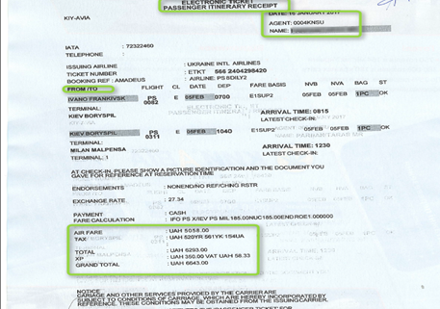
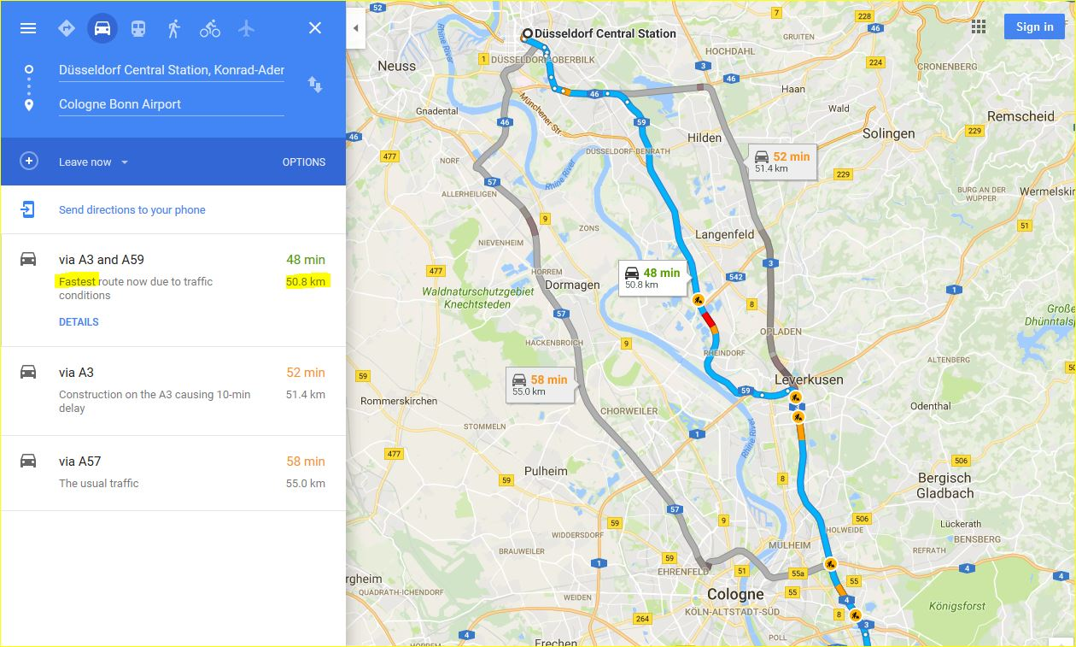
Long distance travel = cross border travel
Car travel expenses:
Maximum distance 2000 km at
EUR 0.20 per km
EUR 0.30 per km with 2 or more eligible participants
Proof of distance
Trains, bus and ferry expenses:
First, second and business class
You must submit
invoice / receipts
Flight expenses:
Economy class only
Max EUR 1200
Full travel itinerary
Ticket price
Name of passenger

Slide 16
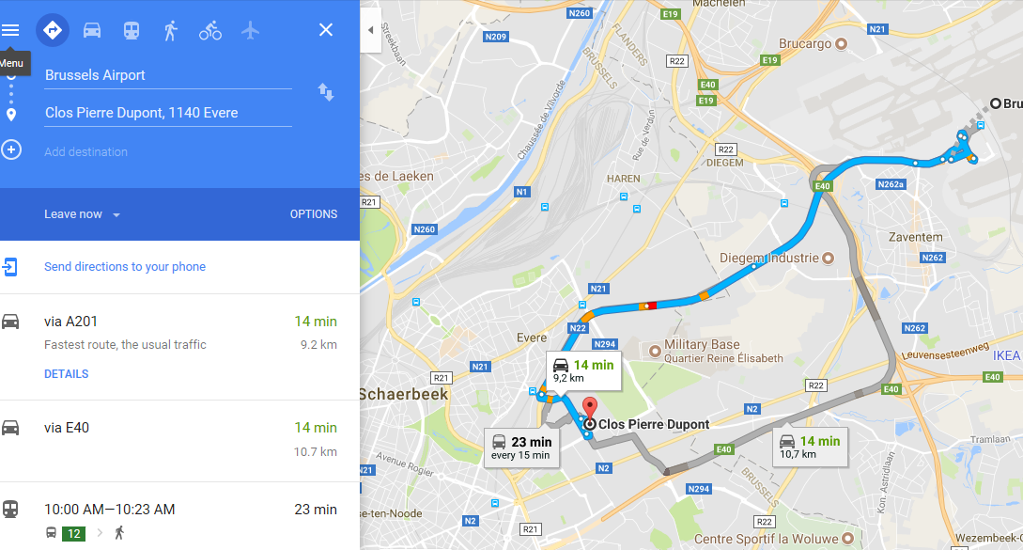
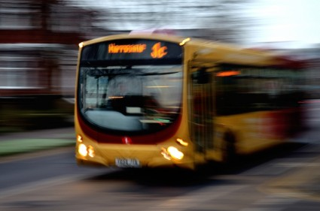
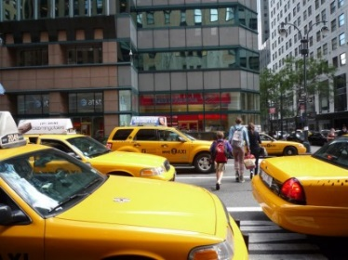
Local Transport – travel within 1 country
Public transport expenses (shuttle, ferry, bus, train, metro and tram):
Claimed amount
≤ EUR 25 → No receipts required
Claimed amount
> EUR 25 → All receipts required
Taxi expenses are allowed when:
No other means of public transport is available
To/From airport between 10pm and 7am
AND
Only up to a maximum of EUR 80 in total with receipts
Car travel expenses:
Same rules apply

Slide 17
Other travel eligible expenses
Luggage fees
Parking fees
Entry visa fee

Slide 18
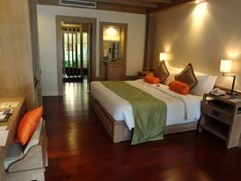
Accommodation expenses
Flat rate: EUR 120 per night
No receipts
Maximum nights = actual number of meeting days attended + 1 night before the event
MC decision: lower flat rate
Same flat rate

Slide 19
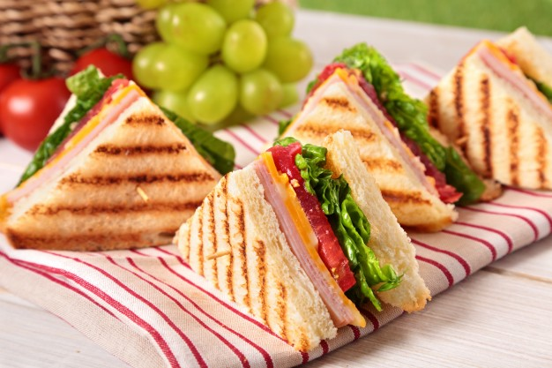
Meals expenses
Flat rate: EUR 20 for lunch and dinner
No receipts
Based on travel times
Offered meals by Local
Organiser Support (LOS)
MC decision: lower flat rate
Same flat rate

Slide 20
Non-eligible expenses
Registration, lecture fees and honoraria
Insurance (life, medical, health, luggage, etc.)
Fuel, road tolls and car rental
Charges for a rebooked travel ticket
Expenses associated with obtaining visas

Slide 21
How to submit your
Online Travel Reimbursement
Request (OTRR)

Slide 22
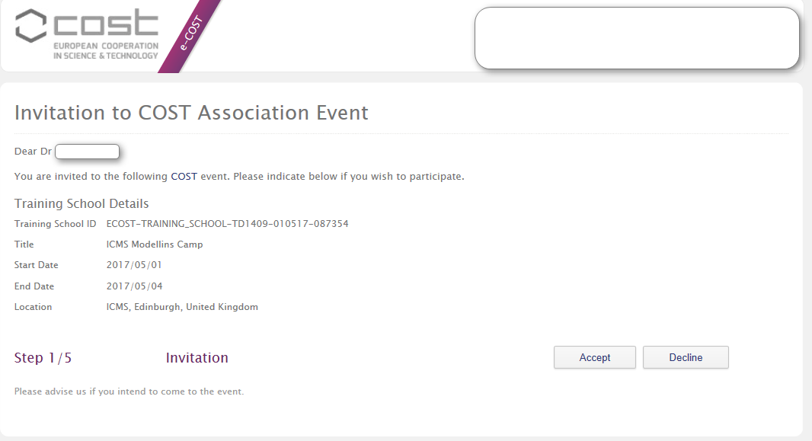
Step 1/5 Accept or Decline

Slide 23
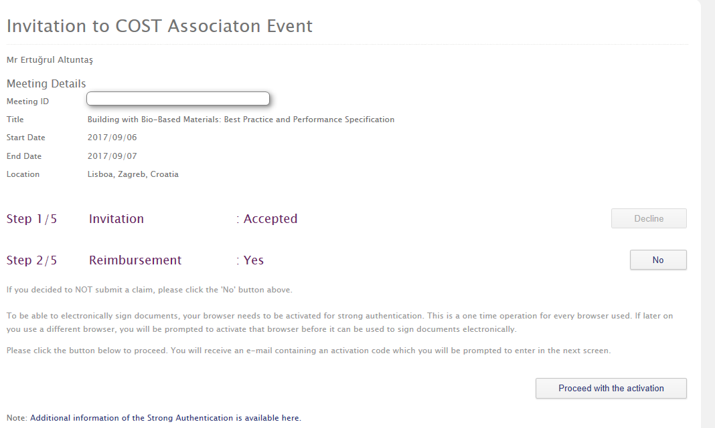
Step 2/5 Reimbursement?

Slide 24
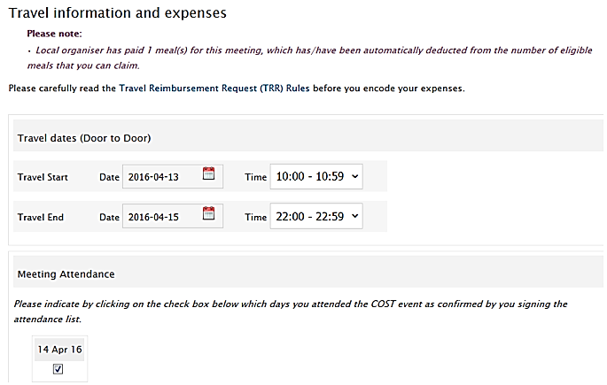
Step 3/5 Fill in your travel expenses

Slide 25
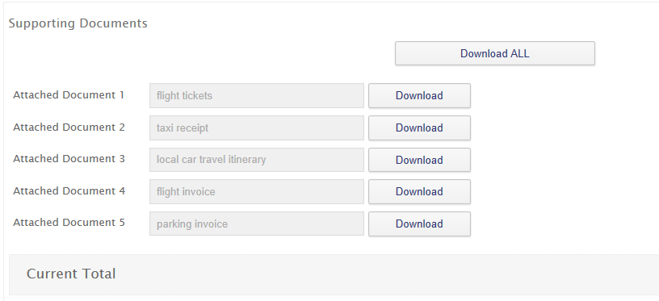
Upload receipts

Slide 26
Step 4/5 Select Bank account

Slide 27
Step 5/5 Submission

Slide 28
Communicating with COST
Communicate only outcomes of MC decisions
Always indicate your Action number

Slide 29
Thank you

